Slide 1

CAR ACCIDENT DATASET
Fundamental of Machine Learning
ROHITH RAVURI

Slide 2


Objective of the Study
Descriptive Statistics
Choosing Relevant Features for the Study
Findings of K-Means Clustering
Findings of Hierarchical Clustering
Comparing both the Methods
Conclusions
AGENDA

Slide 3
Purpose:
Objective- "What distinct patterns of road accidents can be identified in the dataset, and how can these patterns help in formulating targeted safety measures?"
Identify Clusters of Accidents:
Determine groups of accidents based on similarities in variables such as location, time, weather conditions, and type of vehicles involved.
What is the Objective?
Number of Rows
307,973
Number of Columns
21
Categorical Variables
16
Numerical Variables
5
Notes:
The purpose behind clustering road accident is to find inherent groups in the data based on similarities across factors like location, time, weather conditions and vehicle types.
This information can be valuable for a range of stakeholders-
Safety Measures and Resource Allocation
Urban Planning and Infrastructure Development
Policy Making
Things that we should work on-
How did you remove the missing values, which method did you use to remove the missing values?
Clustering output from the methods!
How did you remove the missing values, which method did you use to remove the missing values?
Clustering output from the methods!

Slide 4
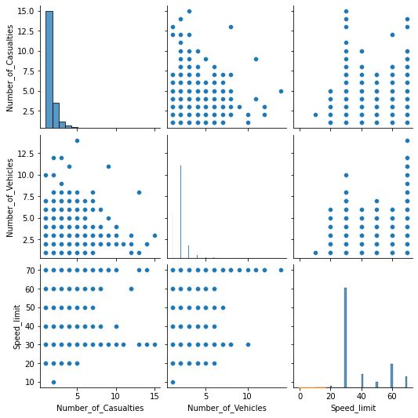
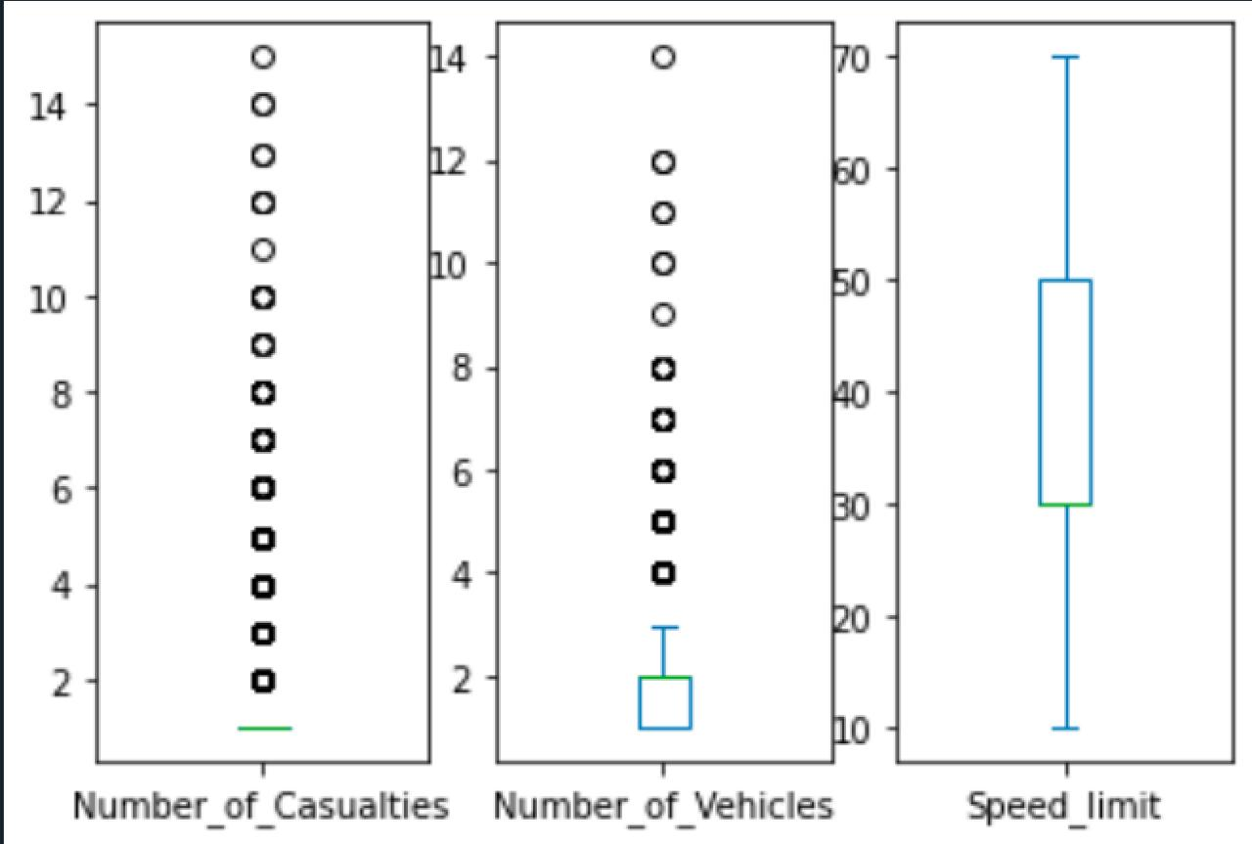
Descriptive Statistics
Multiple-Scatter Plot
Number of Casualties:
The data is concentrated at the lower end, suggesting that accidents with a high number of casualties are less frequent.
There are numerous outliers, indicating incidents with unusually high casualty counts compared to the rest.
Number of Vehicles:
The distribution of vehicles involved in accidents appears to be slightly more spread out than the casualties but still indicates that accidents typically involve a small number of vehicles.
The presence of outliers suggests that there are some accidents involving many vehicles, though these are not the norm.
Speed limit:
The median speed limit is around 30, which could indicate that many accidents occur in areas with this speed limit, such as urban areas.
There's a wide range of outliers, particularly on the upper end, indicating that some accidents occur at locations with very high-speed limits.
.
Number of Casualties vs. Number of Vehicles:
There doesn't seem to be a clear correlation between the number of vehicles involved in an accident and the number of casualties.
The data points are widely scattered, suggesting varied outcomes depending on the specific circumstances of each accident.
Number of Casualties vs. Speed limit:
Again, there is no evident correlation between speed limit and the number of casualties.
It's interesting to note clusters of data points at specific speed limits (such as around 30, likely indicating urban speed limits).
Number of Vehicles vs. Speed limit:
There's no strong correlation visible.
Similar to the previous plot, there are clusters of points at specific speed limits.
Box-Plot
Multiple-Scatter Plot

Slide 5
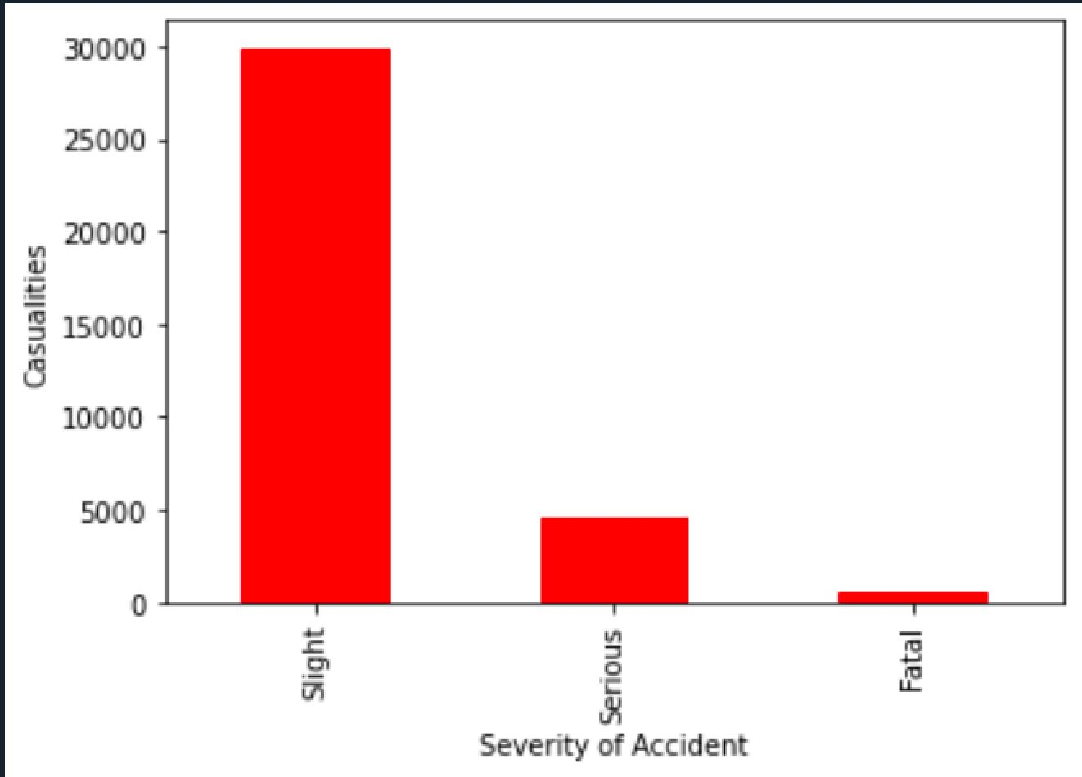
.
Slight Accidents
Bar Chart
Most accidents result in only slight injuries. This is reflected in the high bar for 'Slight', indicating that while accidents may be frequent, they often do not result in serious harm to the individuals involved.
Serious Accidents
A significantly lower number of accidents are categorized as serious, as indicated by the much shorter bar. This suggests that while less common, there is still a considerable number of incidents that result in serious injury.
Fatal Accidents
The bar for 'Fatal' is very small, which indicates that fatal accidents are relatively rare compared to the other categories. However, even a small number is significant when it comes to loss of life

Slide 6

Missing Values
We converted the missing values into Dummy variables, and then ran the models.
We removed certain features beforehand, such as carriageway hazards, and accident index number.
97% of data in Carriageway hazards was missing.
Accident Index no. column was just a serial number, so we removed it, because it won’t add anything to our analysis.

Slide 7

We structured the data, by converting the time in categorical variables.
Where, we designated the hours 0-6 AM as midnight, 6-11:59 AM as morning, and so on and so forth.
Moreover, we eliminated the values that were missing in order to do additional research.
Following this step, we transformed the categorical variables into numeric values in order to run the correlation plot. This allowed us to determine whether any of the features relate to the other features.
Feature Engineering

Slide 8
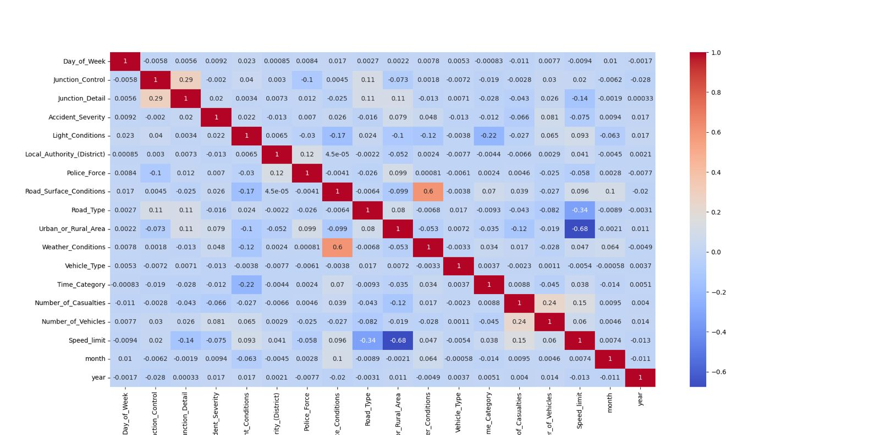
We have made use of heat map to understand how different variables are related to one another. Here’s an analysis of the heatmap:
Strong positive correlation- No. of vehicles and no. of causalities seem to have some degree of positive correlation, which means more vehicles involved in an accident might lead to more casualties.
Weak Correlation- Many variables such as Weather conditions, speed limit, day of week show very little correlation.
Strong Negative Correlations- There does not seem to appear any pairs with a strong negative correlation.
Feature Selection
A Snapshot of The Heatmap
Notes:
Other Observations from the Heat Map-
Diagonal- The diagonal from top-left shows a perfect positive correlation, as it is correlating each variable with itself.

Slide 9
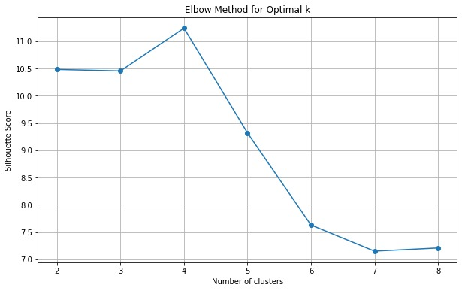
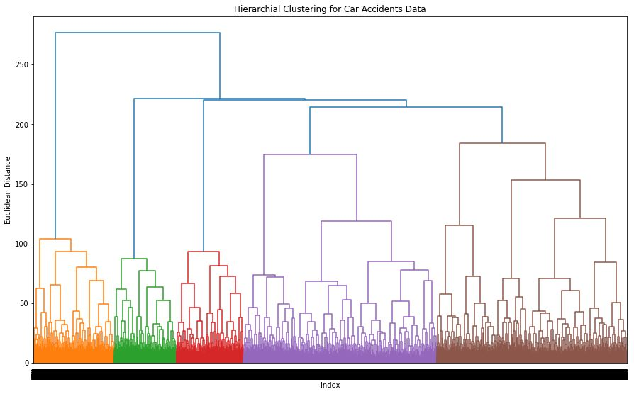
Comparing both the Models
K-Means
After analyzing the elbow curve, we got to know that k=4 will be best clusters for our analysis. So, we used k=4 in our model.
After running the algorithm, the silhouette score came out to be 0.102632.
Which shows that the accuracy of our model in predicting the road accidents is only 10.26%.
.
After comparing the silhouette scores of both the models, we came to know that our Hierarchical model was comparatively better at predicting the road accidents than K-Means.
Hierarchical Clustering
We plotted a dendrogram and found that only 2 clusters made sense. That’s why, went ahead with 2 clusters for the model.
After running the algorithm, the silhouette score came out to be 0.122664
Which shows that the accuracy of our model is only 12%. Model is only able to predict 12% of the accidents.
.
Notes:
The accuracy we received from Hierarchical clustering is also quite low, model prediction for road accident is very poor.

Slide 10
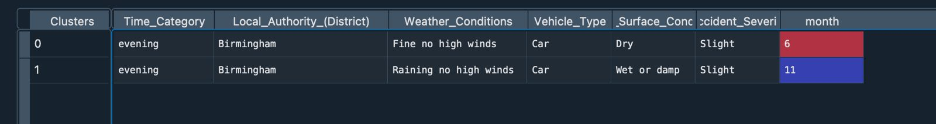
Cluster 0: “Clear Evenings, Dry Conditions”
Time Category: 'Evening' suggests the accidents occurred during peak traffic hours, when people typically commute back from work.
Weather & Road Conditions: 'Fine no high winds' and 'Dry' suggest good driving conditions, which might lead to driver complacency or overconfidence in vehicle control.
Location: 'Birmingham' could indicate an urban environment with potentially heavy traffic and complex driving environments.
Accident Severity: 'Slight' severity means the accidents were not severe, which could be due to lower speeds in urban traffic or effective safety measures already in place.
Month: Occurring in June, a time of longer daylight hours in the UK, which typically sees an increase in after-work travel and leisure activities.
Final Analysis
Cluster 1: “Rainy Evenings, Wet Roads”
Weather & Road Conditions: 'Raining no high winds' and 'Wet or damp' point to conditions that can significantly impact road safety due to reduced visibility and increased stopping distances.
Month: November is a time when days are shorter and weather conditions can be poor due to the onset of winter, which can be challenging for drivers not yet accustomed to winter driving after the summer months.

Slide 11
Cluster 0: “Clear Evenings, Dry Conditions”
Safety Measures:
Awareness Campaigns: Reminding drivers to stay vigilant even in good conditions.
Traffic Flow Improvements: Considering adjustments to traffic light timings to reduce congestion during evening rush hours.
Monitoring and Evaluation: Analysing whether specific intersections or streets are accident-prone.
Cluster 1: “Rainy Evenings, Wet Roads”
Safety Measures:
Infrastructure: Ensure road markings are visible and reflective, and that drainage systems are effective in removing excess water from road surfaces.
Driver Assistance: Encouraging the use of vehicles equipped with modern safety features such as anti-lock braking systems (ABS) and electronic stability control (ESC), which are particularly useful in wet conditions.
Seasonal Preparedness: Special campaigns to prepare drivers for the change in seasons, emphasizing the need for increased caution during the first few weeks of rainy weather.
Safety Measures

Slide 12
Thank You

